Slide 1
Gun Violence - Team 4
Team members:
Snigdha Reddy Pulim
Patrick Wright
Tarek Mourad
Vaishnavi Vadlamudi

Slide 2
Understanding Gun Violence in Boston's District 4
Councilor Worrell, Boston City Councilman for District 4
Motivation:
The goal of this project is to understand the drivers of gun violence in Boston's District 4 and compare it to the rest of the city. The project aims to determine the rate of gun violence in the district, identify patterns in terms of location and type of violence, and analyze existing programs meant to curb violence. The results of this analysis will inform policies that can be beneficial for improving the district.
Background:
Gun violence has been on the rise among the youth in Boston's District 4, which is a cause of concern for Councilor Worrell. The project will use various data sets and sources, such as police records of violence/firearm activity, discipline records from schools, and police presence to analyze the problem. The team will also gather additional data sets related to schools, environmental/community factors, and interactions to gain a better understanding of the issue.

Slide 3
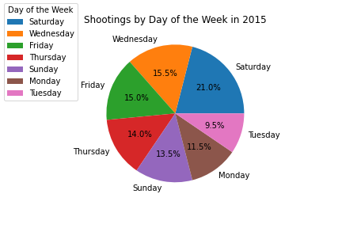
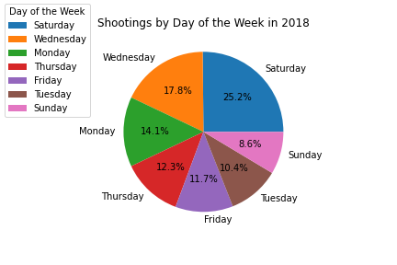
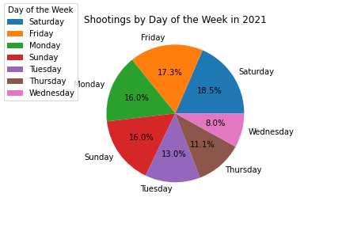
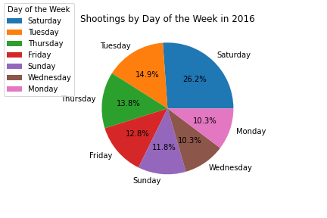
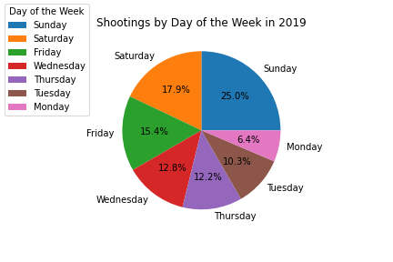
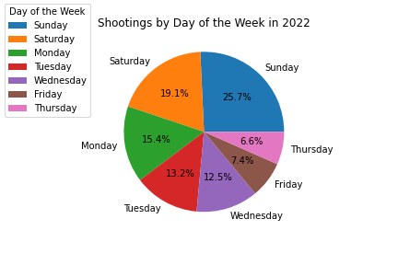
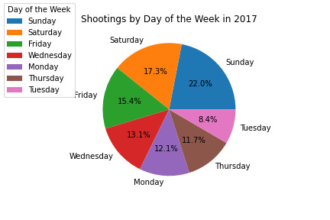
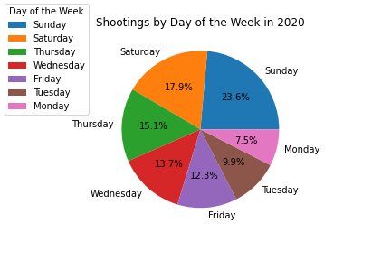
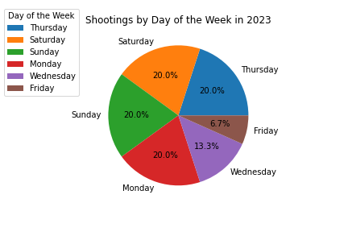
Victim Data of District 4 Shootings
Saturday has highest percentage of shootings from 2015 - 2023, however there seemed to be a dip in its percentages in 2019 and the years that followed (police presence?)
There was not a drastic drop-off because Saturday was still always in the top 2 every year
In 2019 and beyond, Sundays became a much higher percentage
Friday was the third highest among all the data throughout the nine year period
A little over 50% of the shootings within D4 over this time period occurred during the weekend (Fri - Sun)

Slide 4
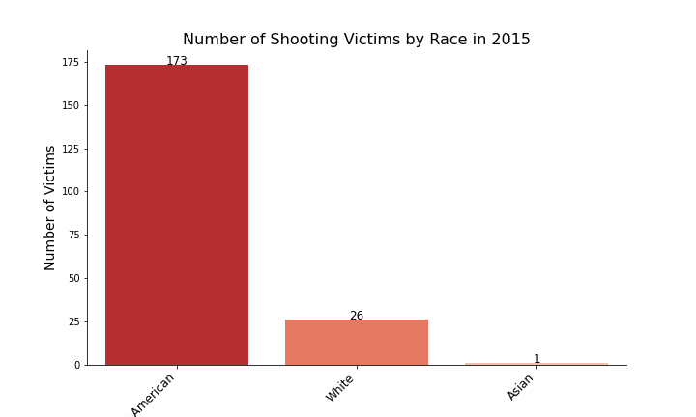
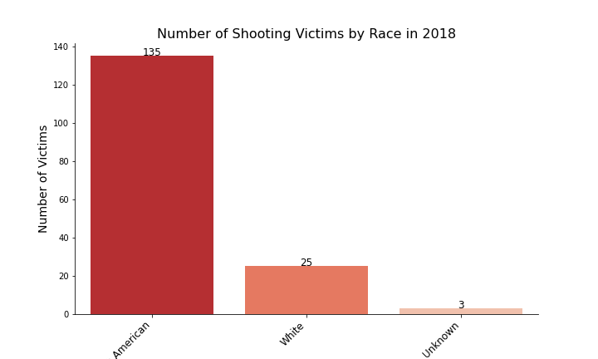
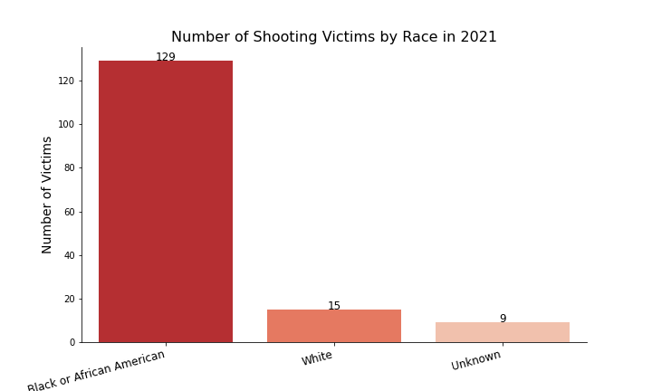
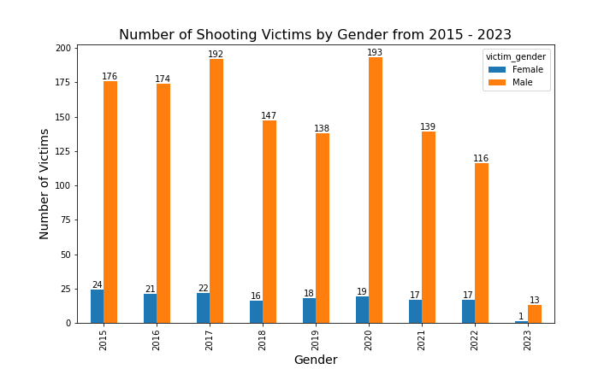
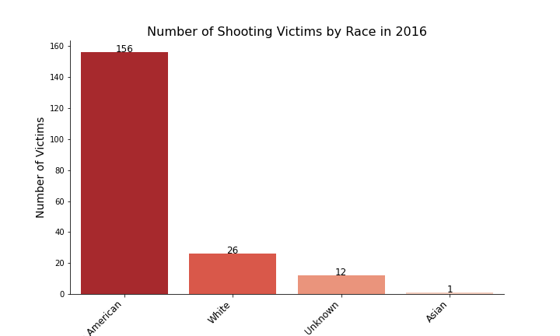

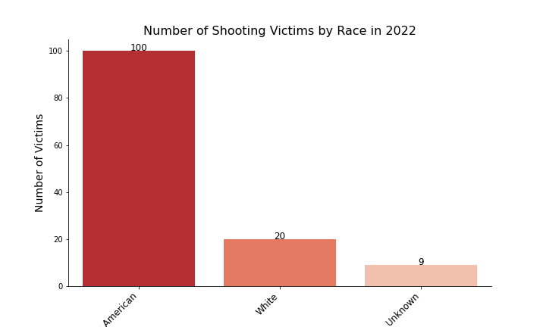
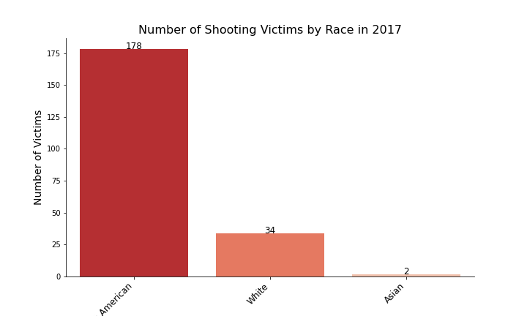

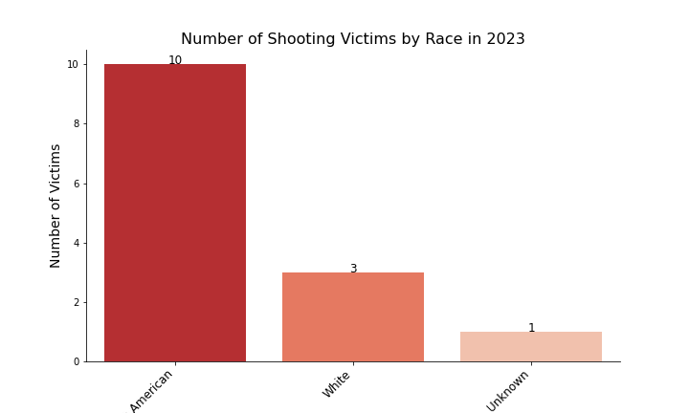
Shootings by Race and Gender in District 4
This data focuses more on the victims rather than the incidents.
Black/African American has the highest number of victims within D4 by a landslide
Number of black victims from 2015 - 2023 is 6x higher than the number of white victims
Many more male than female victims; number of male victims is over 8x that of female victims

Slide 5
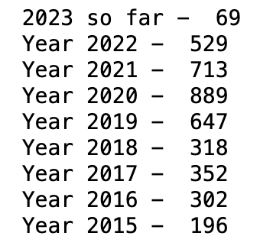
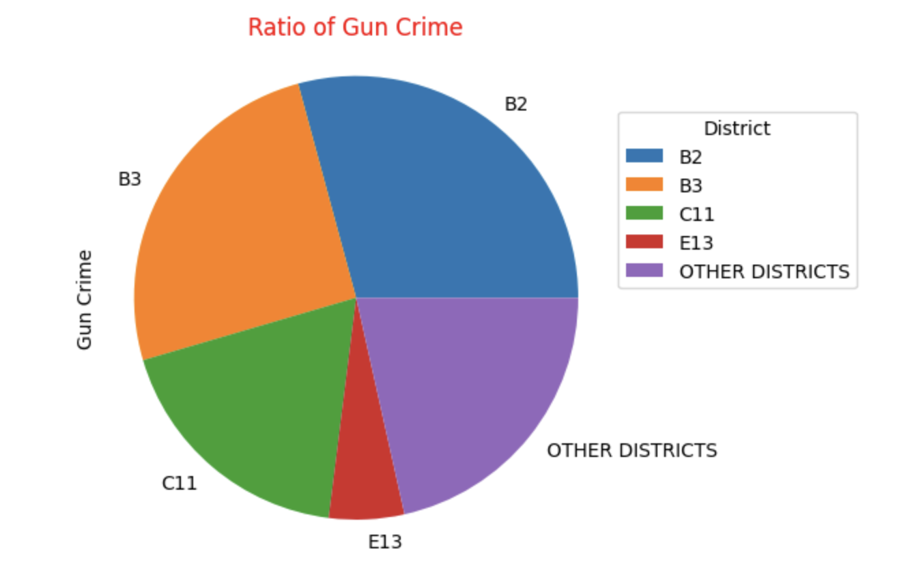
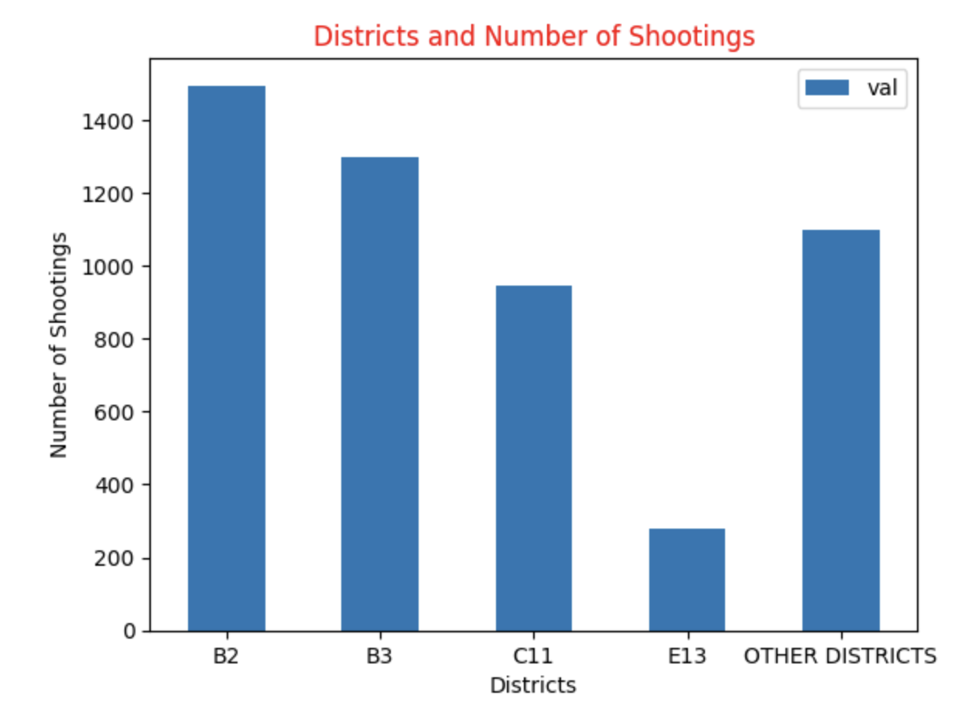
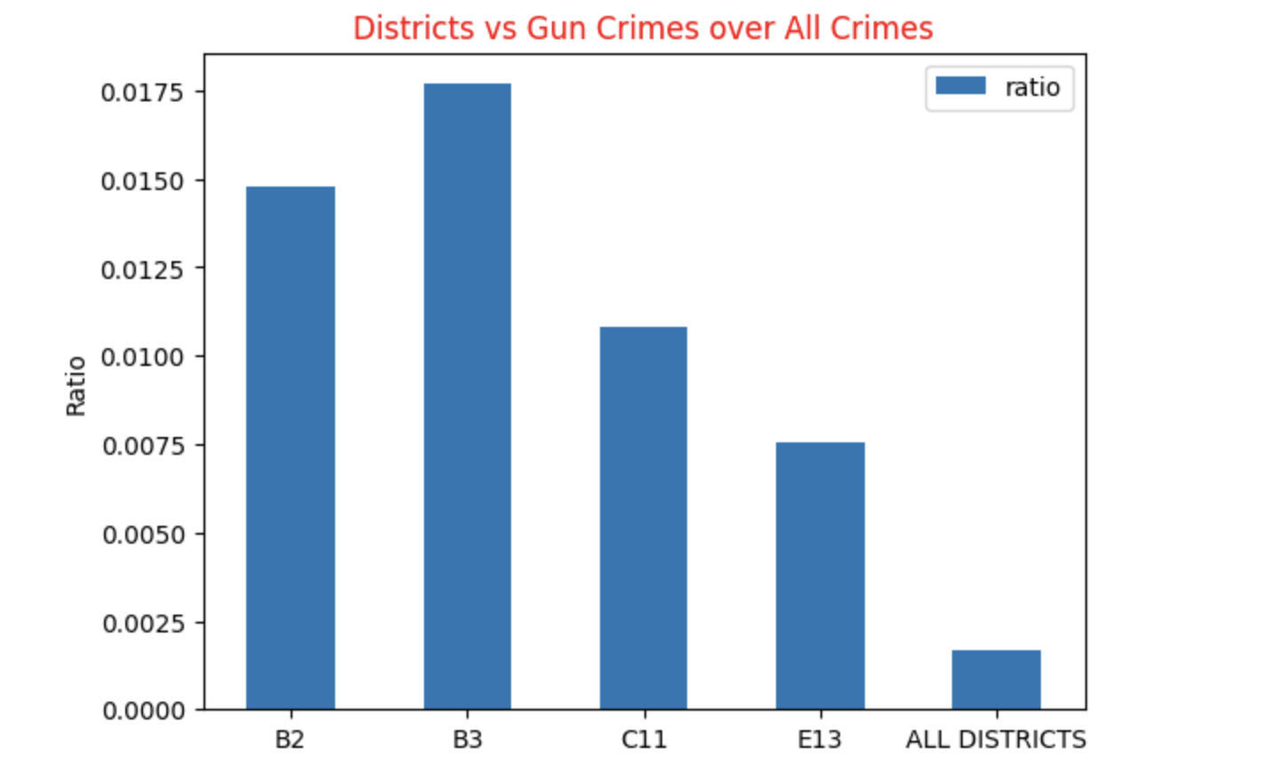
DECREASING TRENDS ON GUN CRIMES REPORTED
NUMBER OF GUN CRIMES REPORTED
Year-on-year growth rates:
From 2015 to 2016: 54.08%
From 2016 to 2017: 16.56%
From 2017 to 2018: -9.66%
From 2018 to 2019: 103.77%
From 2019 to 2020: 37.39%
From 2020 to 2021: -19.80%
From 2021 to 2022: -25.80%
Based on the above calculation, we can see that the year-on-year growth rate has been decreasing over the past few years. This suggests that the trend has been slowing down, and the numbers are not growing as quickly as they have in the past. However, as noted earlier, the latest observation for February 2023 is lower than the previous year's observation, suggesting a decrease in the trend.

Slide 6
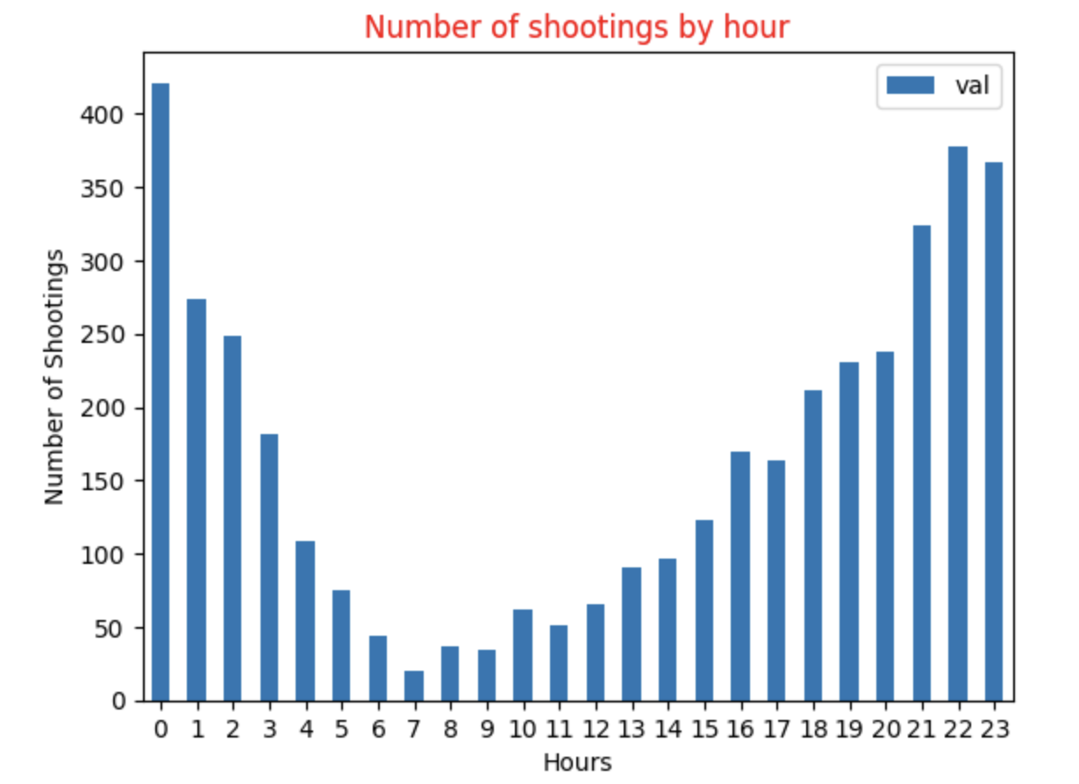
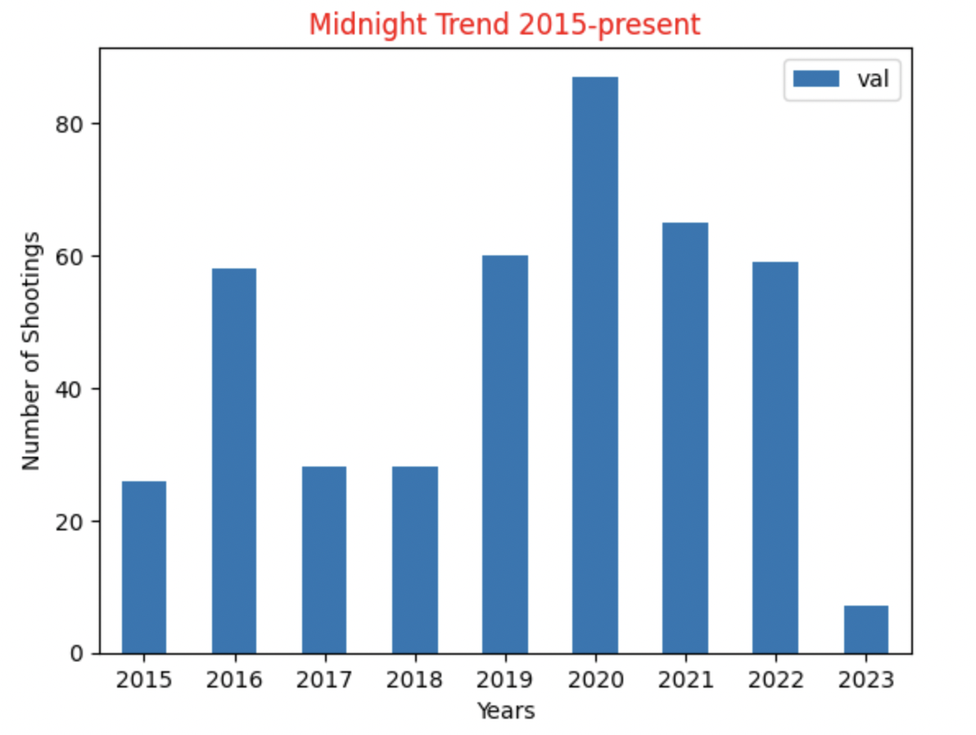
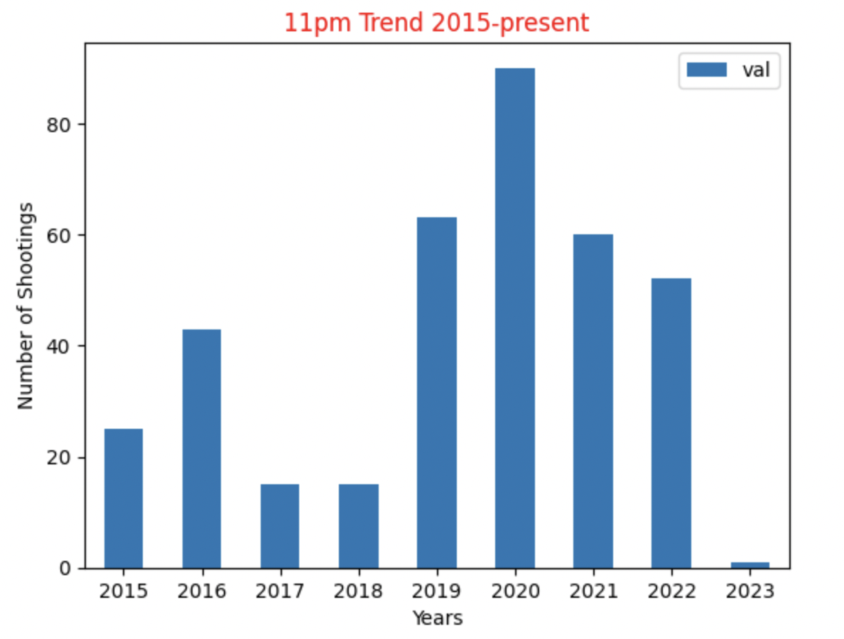
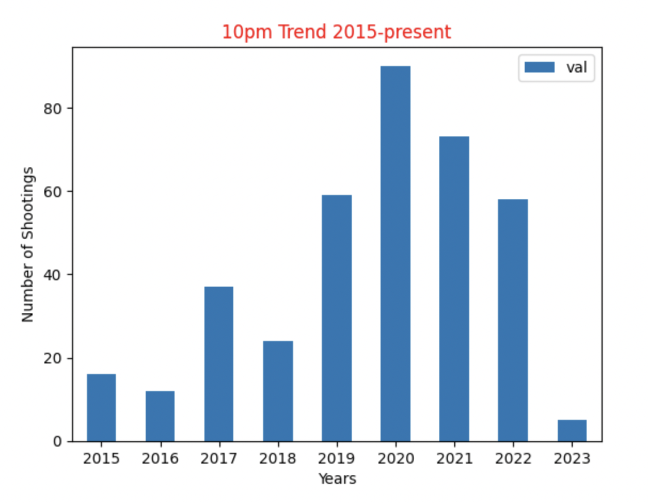
HOURLY TRENDS ON GUN CRIMES REPORTED
Based on the hourly data, We observe that night 10pm to Midnight have the highest number of reports throughout the years and Below are the analysis of these hours.
We observe a decreasing trend in the reported crime incidents in those hours.

Slide 7
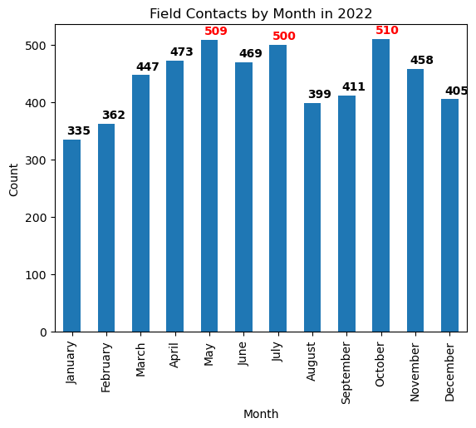
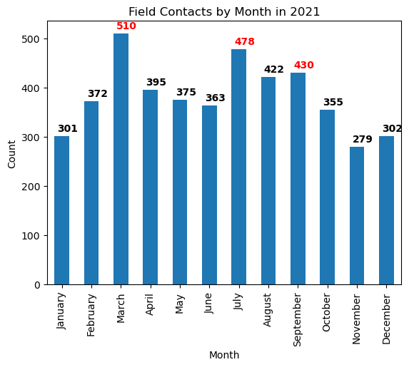
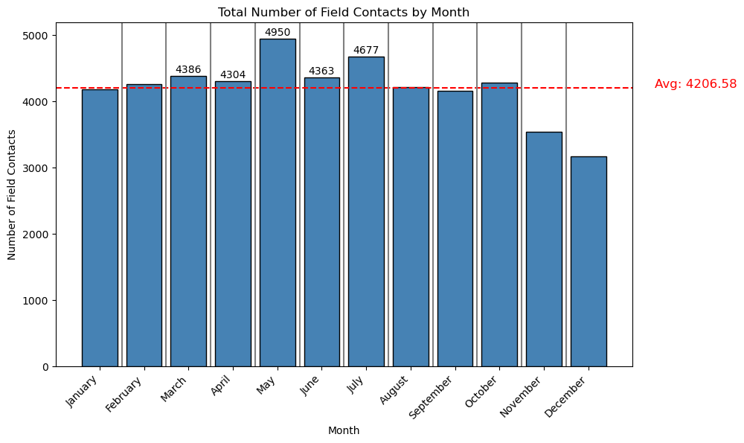
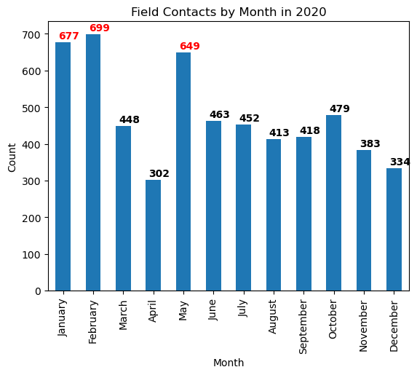
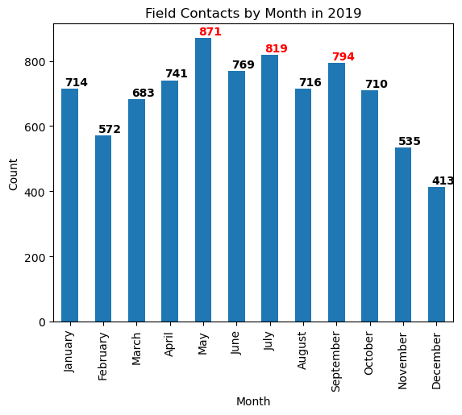
Monthly Field Contacts Data - 2016 / 2022
Field Contact Reasons:
Reasonable suspicion
911 Call
Top 5 months by count:
May (4950)
July (4677)
March (4386)
June (4363)
April (4304)
Notes:
C11 / B3 / E13

Slide 8
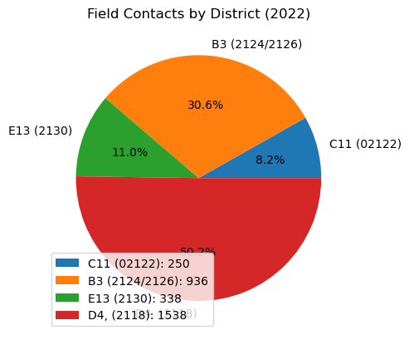
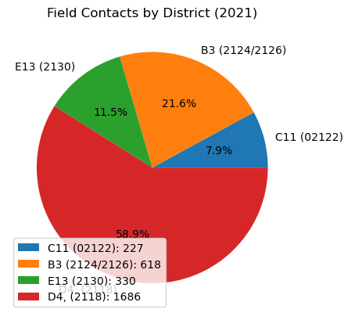
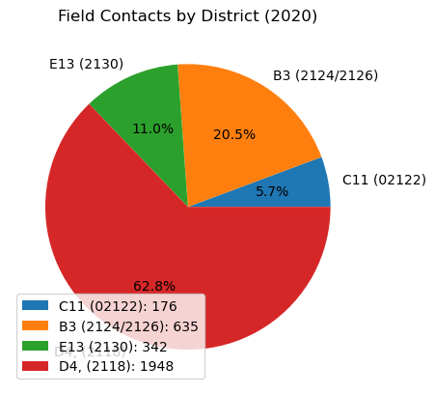
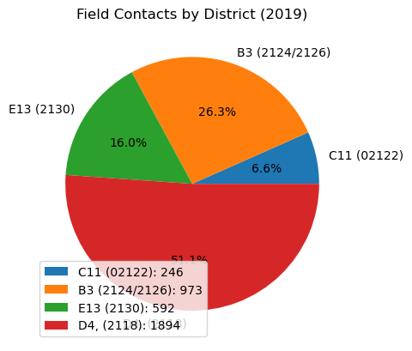
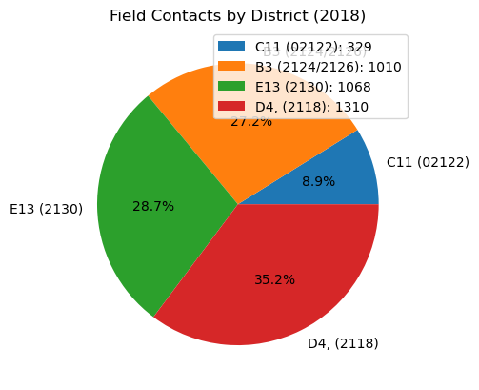
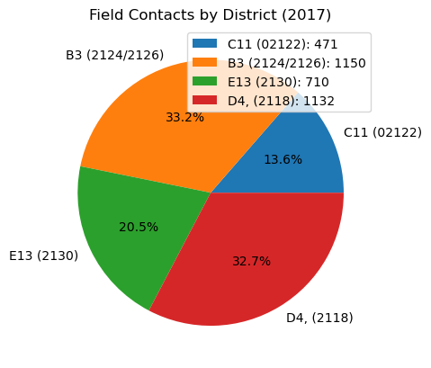
Field Contacts in Districts C11/B3/E13/D4 - 2017 / 2022
Districts Observed:
C11 (02122)
B3 (02124/02126)
E13 (02130)
D4 (02118)
Analysis:
Increase in field contacts in district D4 (~32%-~55%)
Decrease in field contacts in district E13 (~20%-~11%)
Notes:
C11 / B3 / E13

Slide 9
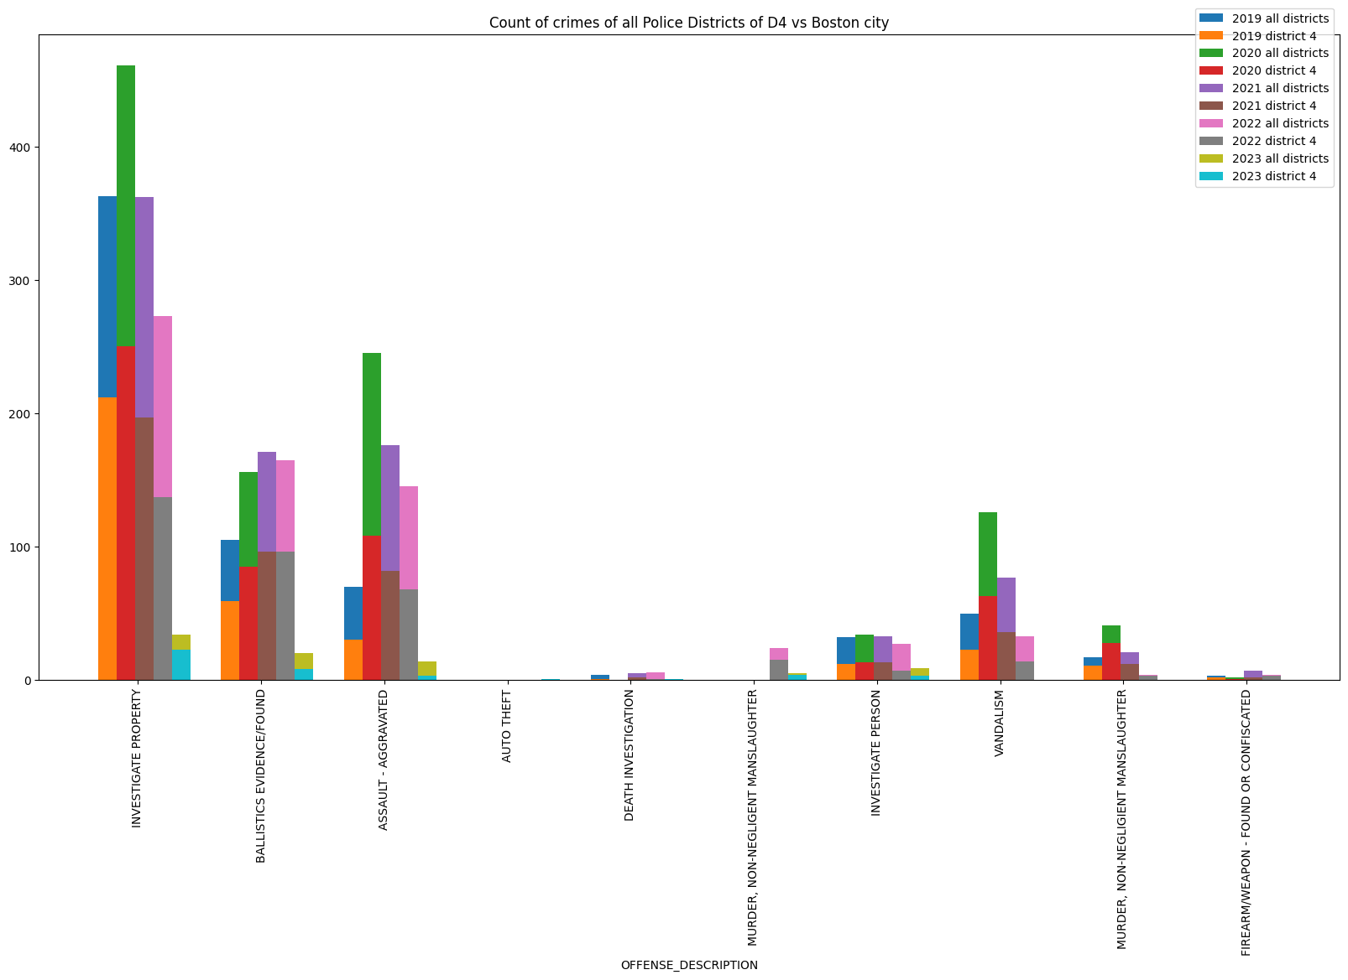
Patterns in terms of Type of violence involving shooting in the last 5 years
Key Points:
Overall, most crimes have consistently reduced after peaking in 2020.
However, Ballistics evidence showed an increase in 2021, making it the peak year for this type of crime.

Slide 10
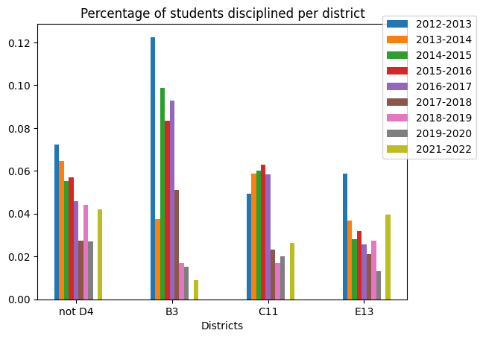
Student Discipline Data analyses
Key Points:
B3 School District had high disciplinary rates compared to other districts
This trend changed from the academic year 2018-2019
There has been a steady decrease in disciplinary rates from 2017-2022 in B3
C11's disciplinary rates have also been significantly smaller since 2016-2017

Slide 11
Exploring Further: A Deeper Look into
BPD FIO vs Shootings
Student Discipline on specific offenses
How does police presence effect crime (especially involving shooting) ?
Analysis of offenses related to gun violence for all districts. And what are the popular offenses?
BPD FIO vs Student Discipline
Is there a correlation between police and the number or kind of students offenses?

